Slide 1


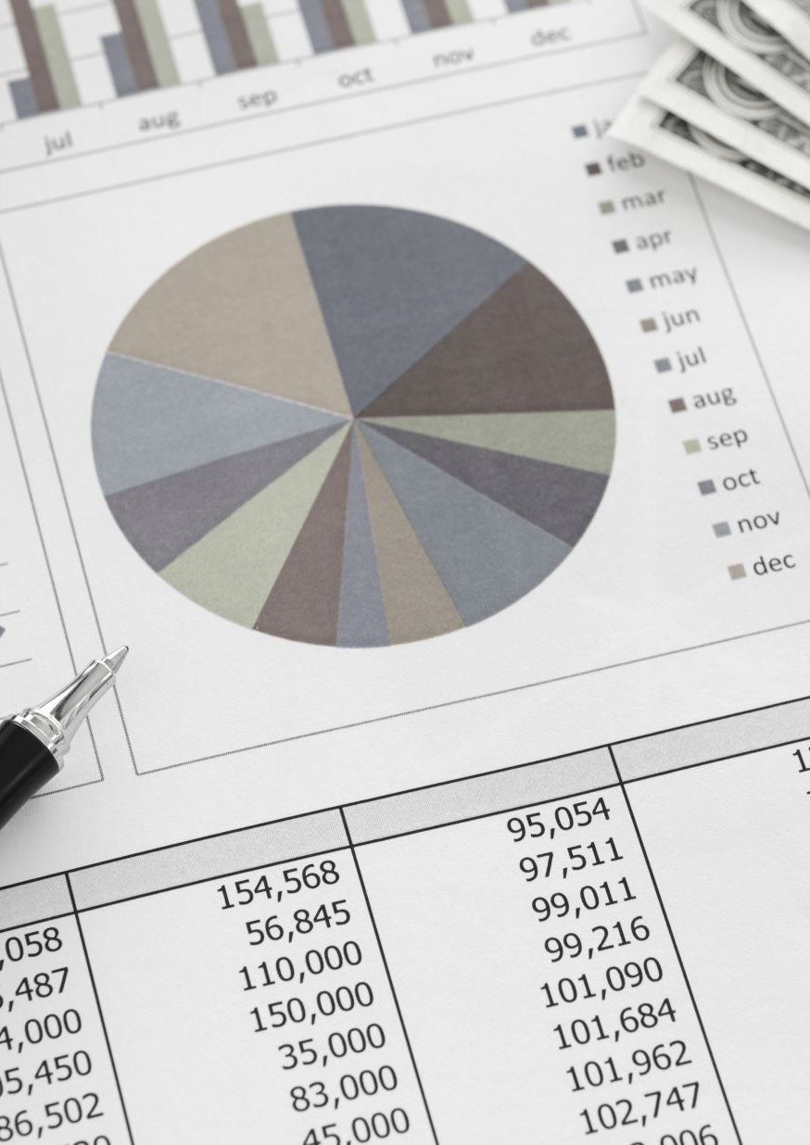

AtliQ Mart Sales And Promotion Analysis
Presented By
Tamanna Jethwani

Slide 2

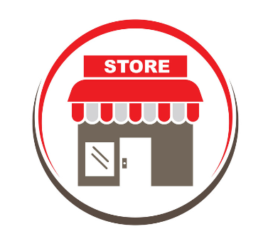

Problem Statement
AtliQ Mart is a retail giant with over 50 supermarkets that ran a massive promotion during Diwali 2023 and Sankranti 2024 on AtliQ branded products.
The Sales director need tangible insights from the Diwali and Sankranti promotions.
He also wants to understand which promotions did well and which did not so
they can make data driven decisions for future promotion events.

Slide 3
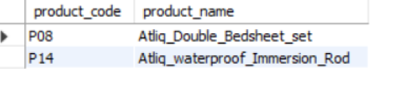
Ad-Hoc-Business-Requests
Business Request 1
Out of all the products sold in AtliQ Mart , the above 2 products are high valued product above 500 and are heavily discounted under Buy One Get One Free promo type

Slide 4
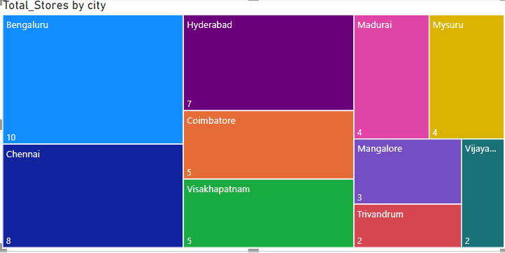
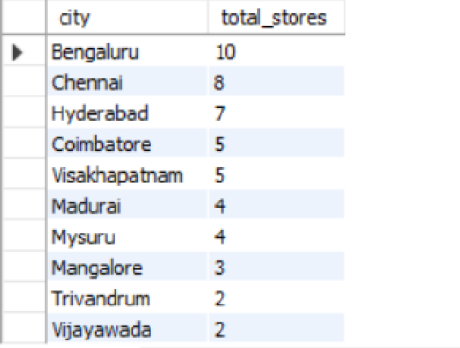
Ad-Hoc-Business-Requests
Business Request 2
These are the total number of stores held by cities. Bengaluru is leading among all.

Slide 5
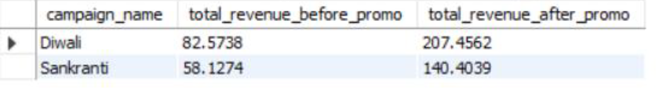
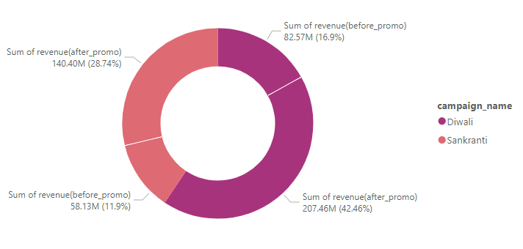
Ad-Hoc-Business-Requests
Business Request 3
Campaign name and their revenue generated before promotions and after promotions

Slide 6
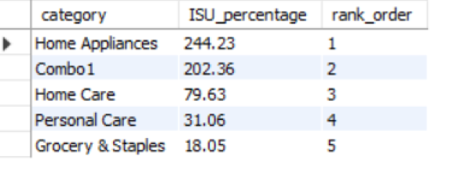
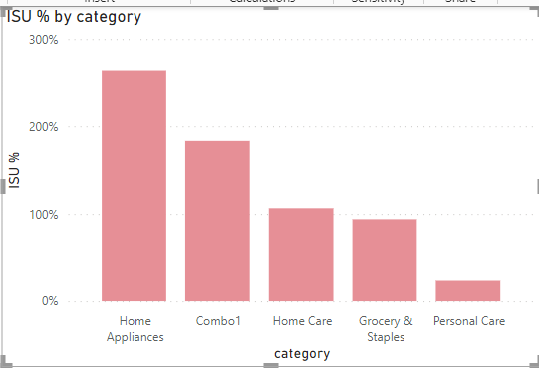
Ad-Hoc-Business-Requests
Business Request 4
The table explains the category wise quantity sold.
ISU indicates the percentage of quantity sold before and after promotion.

Slide 7
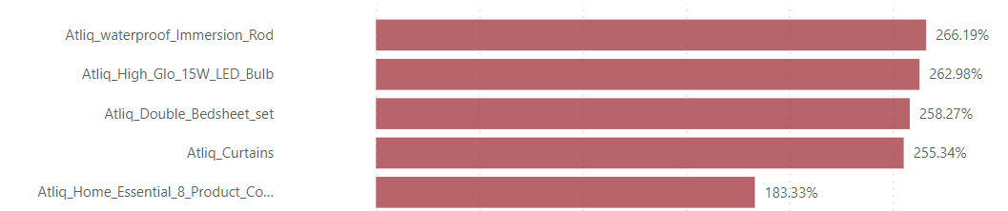
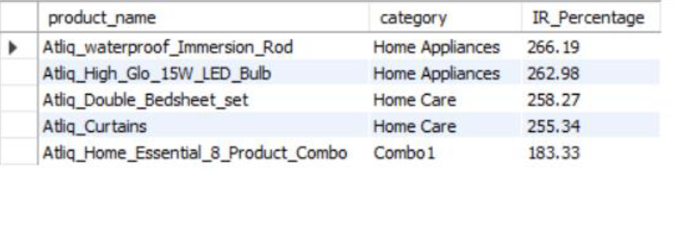
Ad-Hoc-Business-Requests
Business Request 5
The table gives the list of top 5 selling products that generated maximum revenue
IR indicates the percentage increase of revenue before and after promotion.

Slide 8
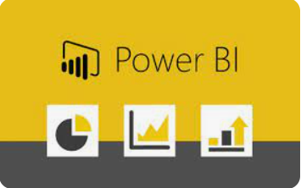
AtliQ Mart Sales And Promotion Analysis Using Power BI

Slide 9
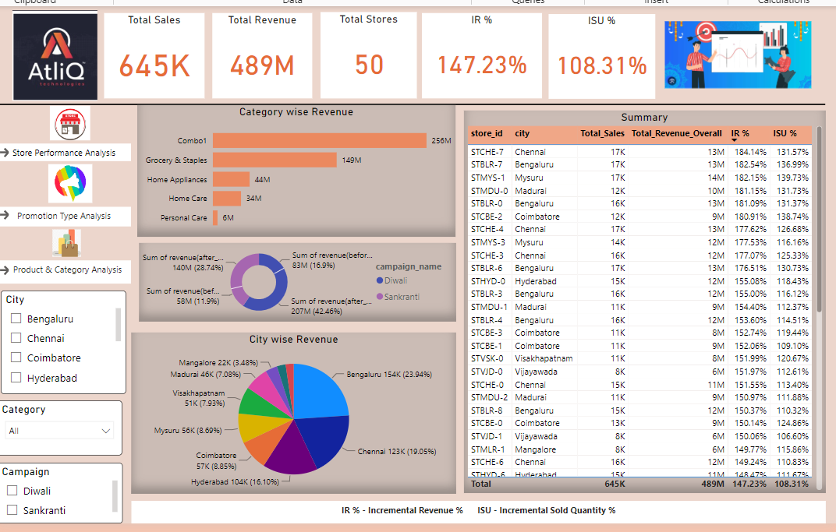
Dashboard View
The Dashboard view gives us the summary of revenue per category, city and campaign. The deeper insights are present under Store Performance Analysis, Promotion Type Analysis and Product and Category Analysis

Slide 10
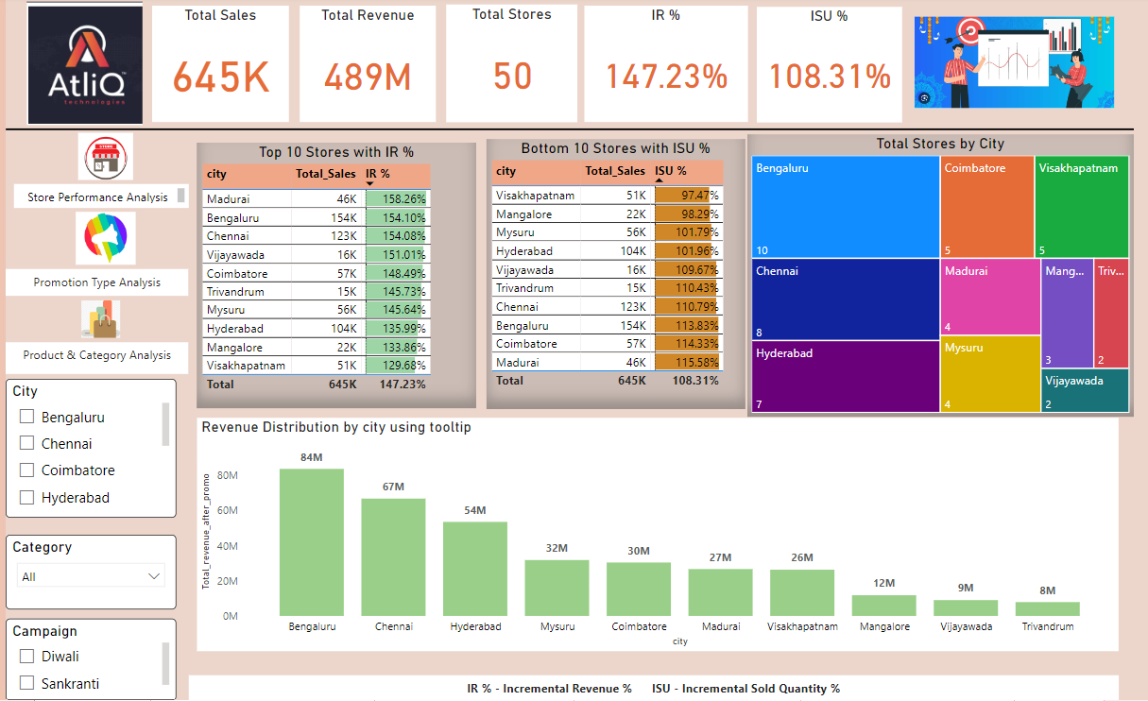
Store Performance Analysis
This view gives us detail insights of stores in terms of quantity sold, revenue generation.

Slide 11
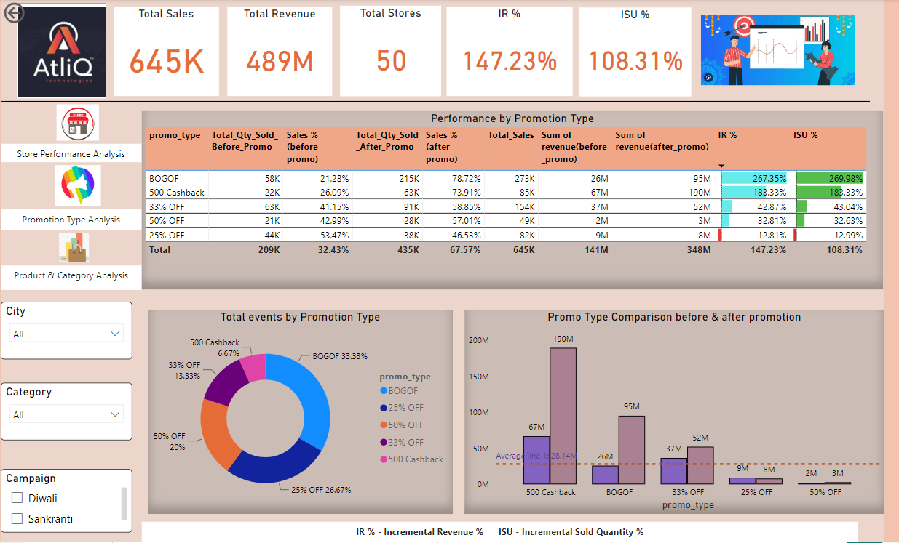
Promotion Type Analysis
The analysis tells us about the performance based on the promotion type applied to the products.

Slide 12
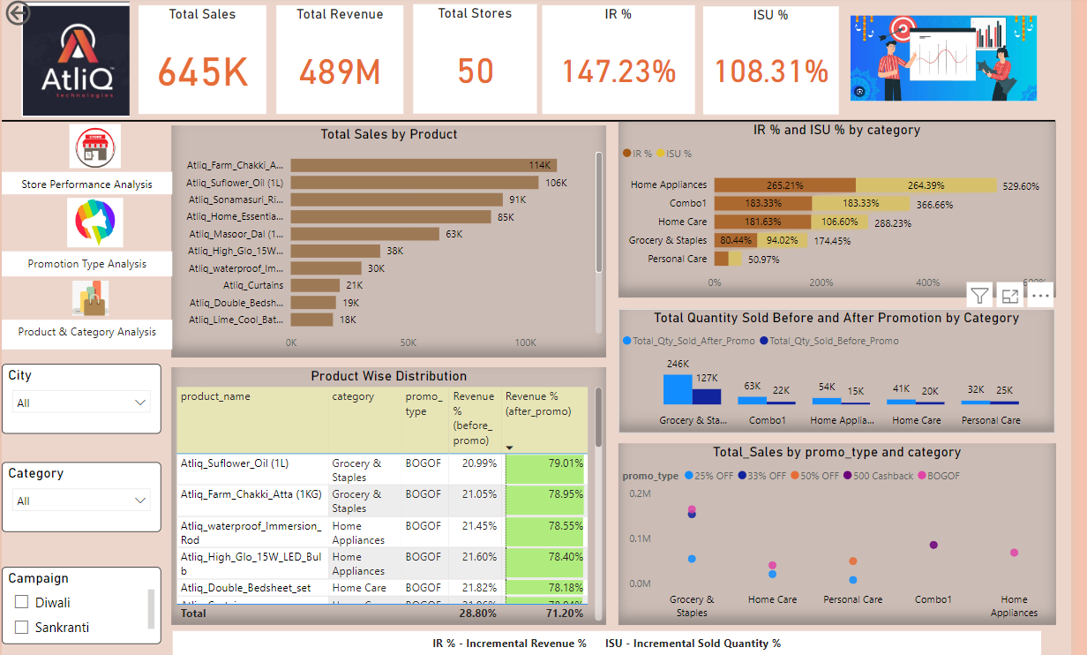
Product and Category Analysis
The product and category analysis gives us detail insights about which product did exceptionally well after the promotions. It also helps us to understand the comparison of before promotion and after promotion figures.

Slide 13
Insights and Recommendation
Store Performance Analysis
Insight - Three major cities that collectively generated major revenue post promotions are Bengaluru, Chennai and Hyderabad. These cities also hold maximum number of stores in the southern part of India.
Recommendation
Given that the above 3 cities have performed substantially well , there should be more focus on customer engagement, good customer service and support, customer retention strategies to further boost sales and revenue.
Continue investing in promotional offers during festive season for other high value products to stimulate sales and attract new customers.
Ensure there is sufficient stock availability to meet the customer demands during festival promotional campaign.

Slide 14
Insights and Recommendation
Promotion type analysis
Insight
Buy One Get One Free (BOGOF) promotion exhibit fantastic performance boasting highest sales and revenue generation numbers when compared other promotion type like 500 Cashback and other discount offers.
Other discount promotions such as 25% OFF, 33% OFF and 50 % OFF could not attract the customers resulting into low IR % and ISU % .
Diwali promotion campaign was more successful than Sankranti.
Recommendation
More promotion offers should be included like 200 cashback , Buy 2 Get 1 free for grocery items per the festive season to boost the sales and revenue.
Planning and effective marketing strategy required for uplifting the sales and revenue numbers for other discount offers.

Slide 15
Insights and Recommendation
Product and Category Analysis
Insight
Among the categories, Grocery & Staples and Combo were the top selling categories during the promotions.
Home Appliances and Combo 1 categories experienced the highest ISU.
Due to BOGOF promotional offer, Grocery items such as AtliQ Sunflower Oil and AltiQ Farm Chakki Atta were among the most purchased item followed by AtliQ waterproof Immersion Rod, AtliQ High Glow 15W LED Bulb, Atliq Double Bedsheet which generated substantially high revenue.
Hence, we can also say that the good promotional deal can lead to higher sales.
Recommendation
Allocate resources and marketing strategies towards categories with higher ISU% to capitalize on seasonal demand so that we can leverage the opportunity for making maximum revenue.

Slide 16


Slide 17
Submission Link
Linkdein-
Github-
Live Interactive Dashboard
Live Video Presentation Link

